Slide 1


당신이 원하는 강의를 검색하세요
WWW

Slide 2
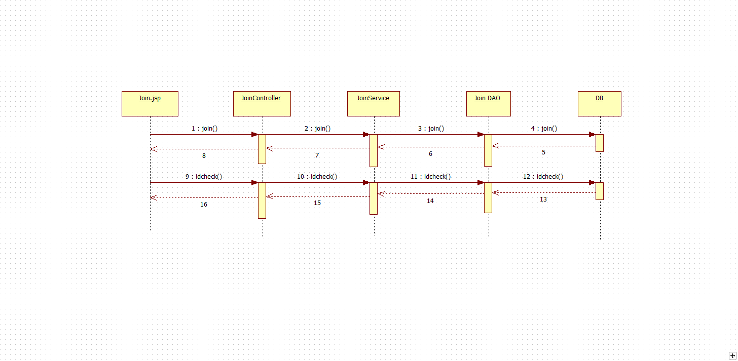

Sequence Diagram

Slide 3
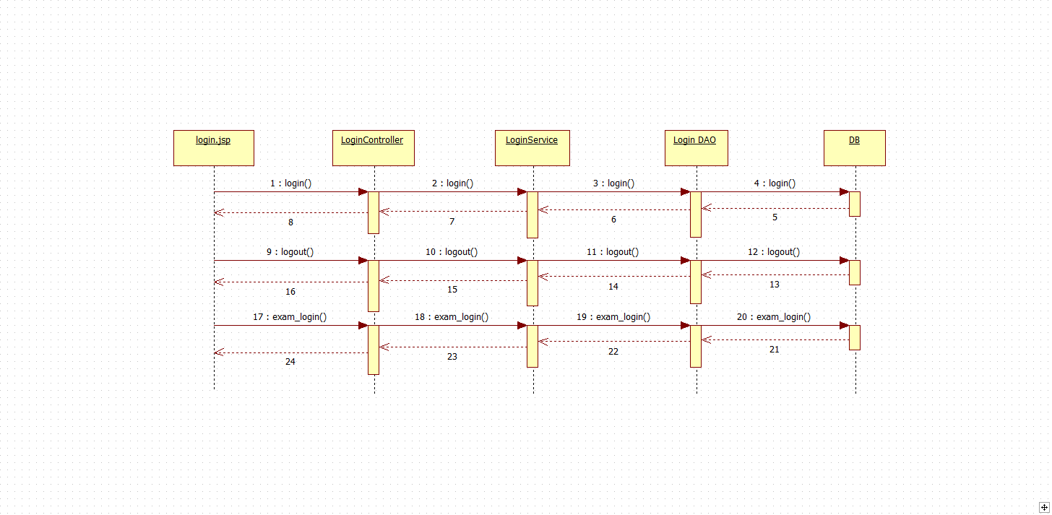
Sequence Diagram

Slide 4
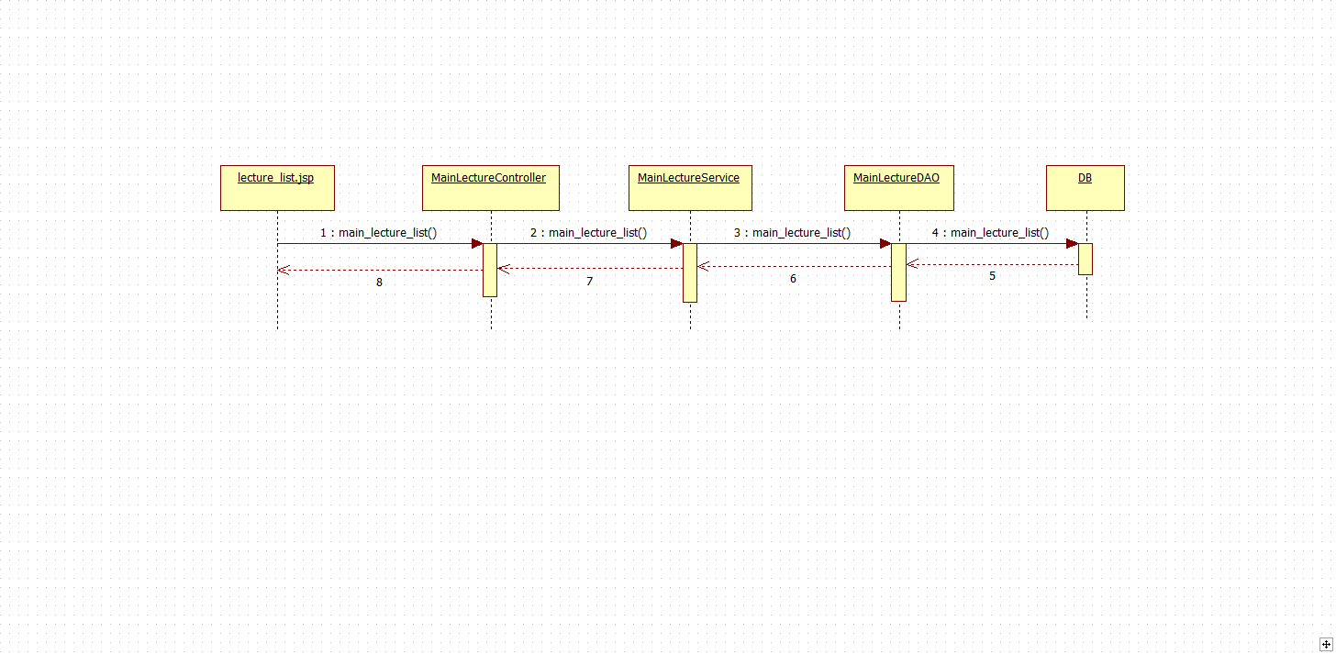
Sequence Diagram

Slide 5
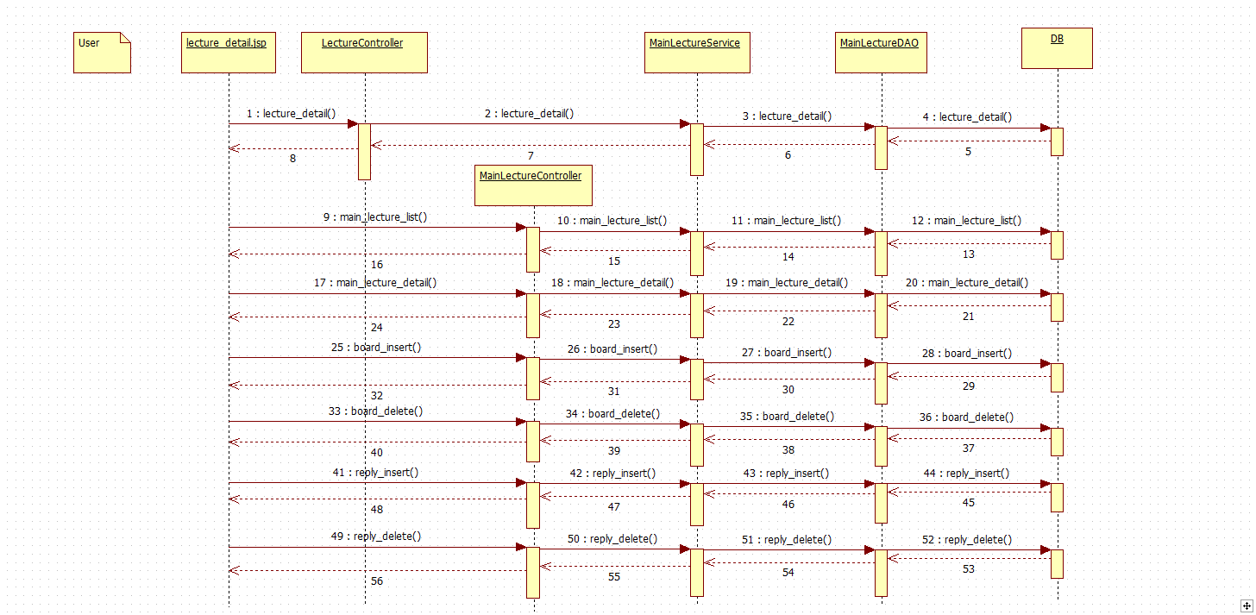
Sequence Diagram

Slide 6
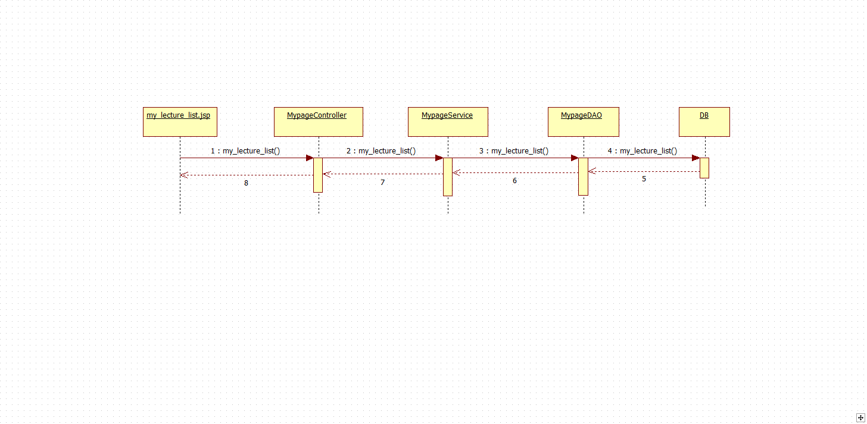
Sequence Diagram

Slide 7
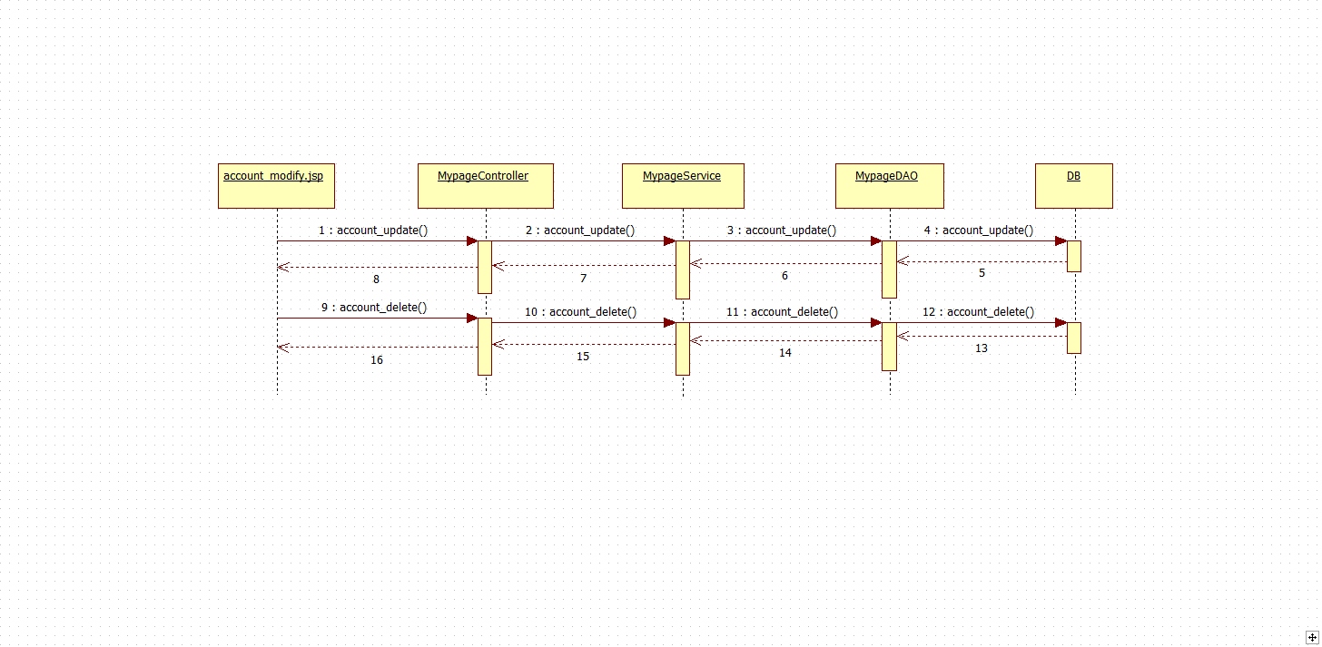
Sequence Diagram

Slide 8
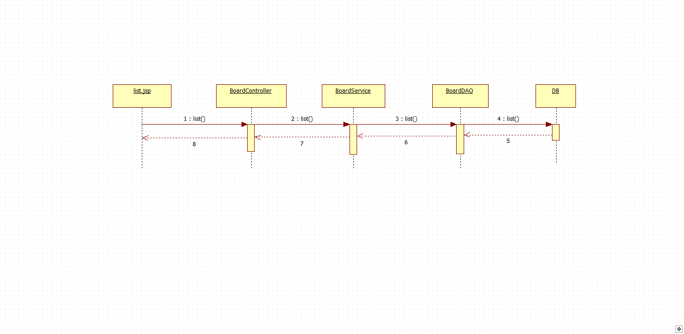
Sequence Diagram

Slide 9
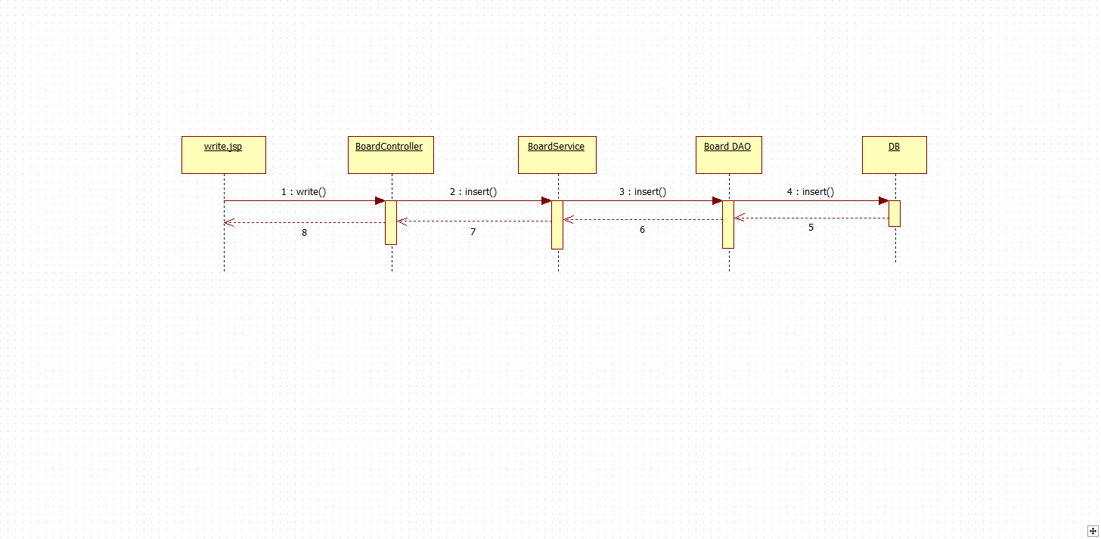
Sequence Diagram

Slide 10
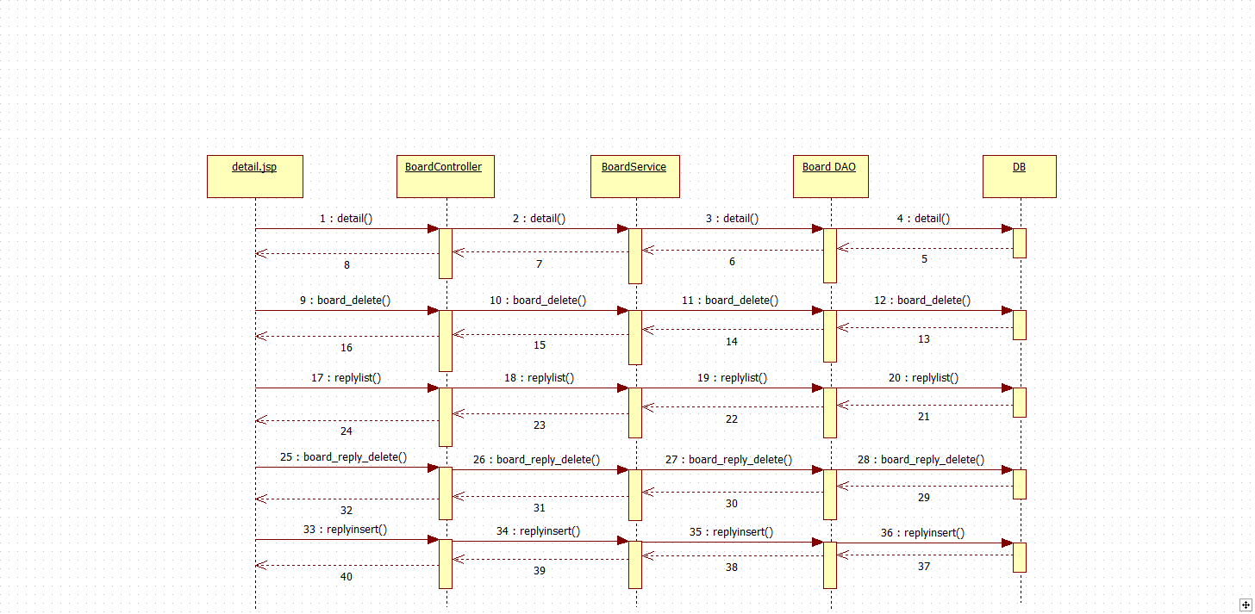
Sequence Diagram

Slide 11
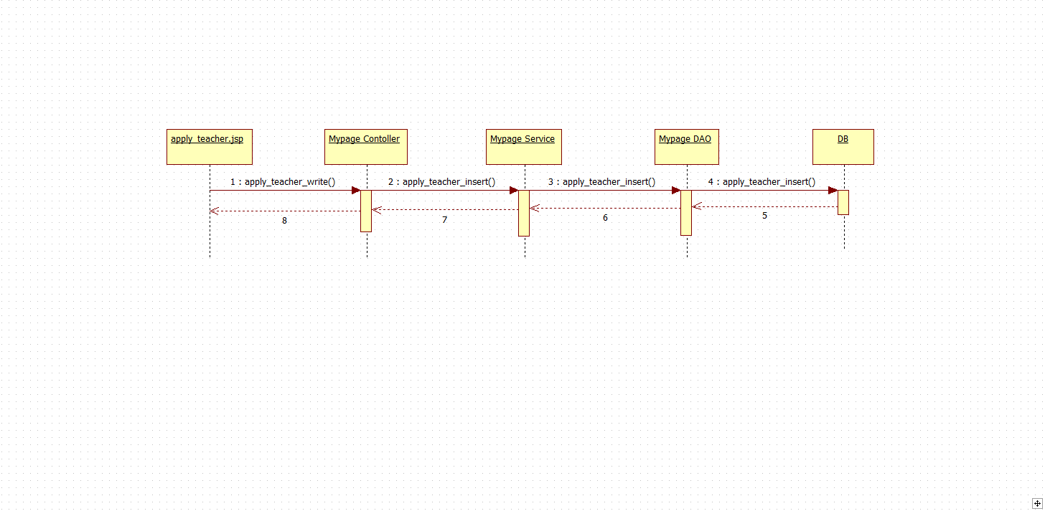
Sequence Diagram

Slide 12
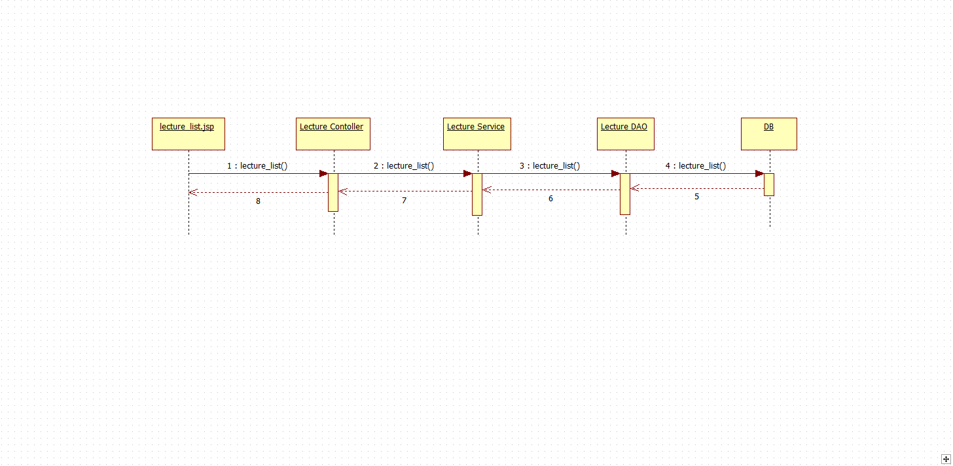
Sequence Diagram

Slide 13
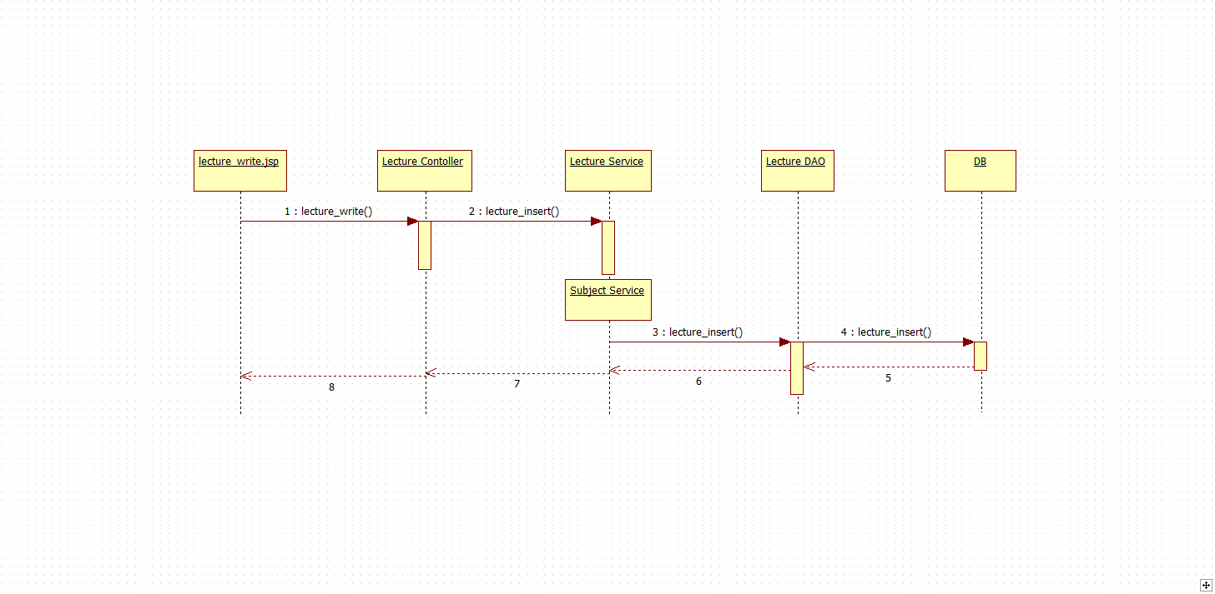
Sequence Diagram

Slide 14
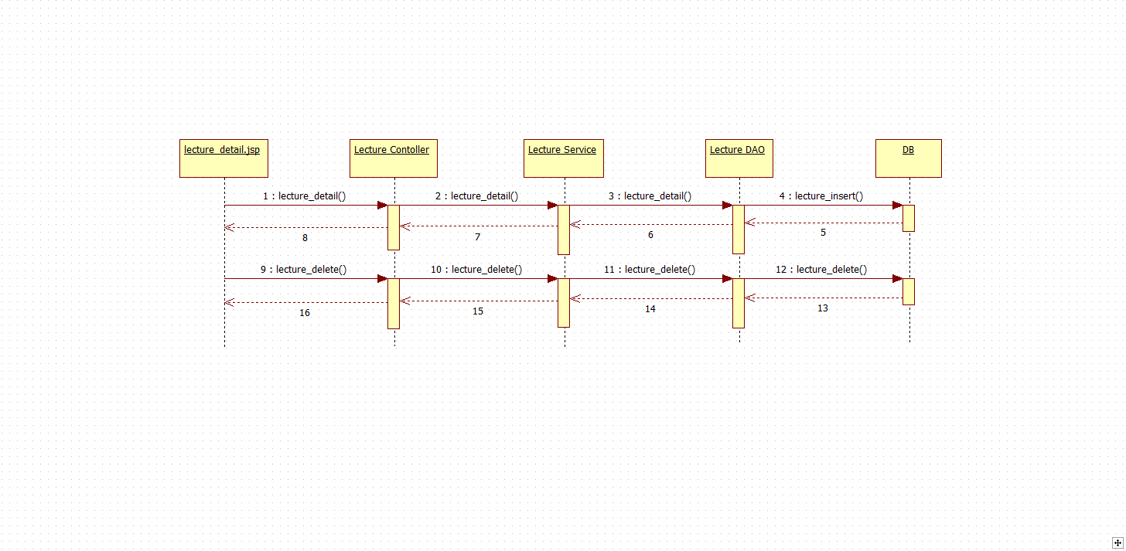
Sequence Diagram

Slide 15
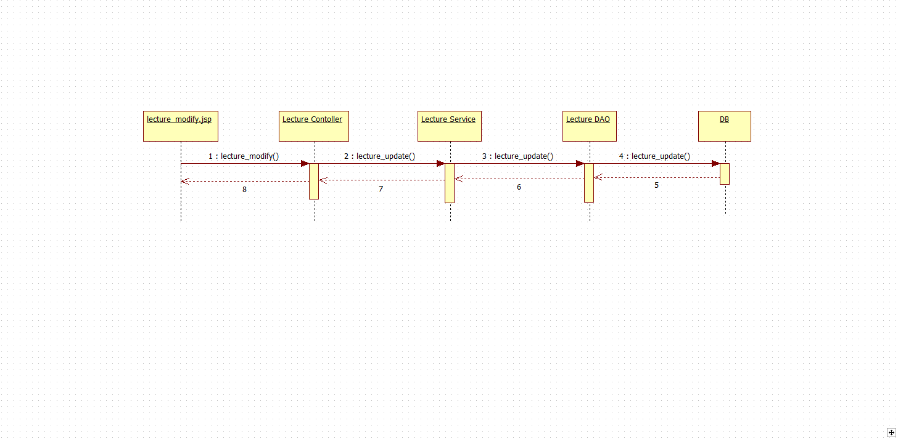
Sequence Diagram

Slide 16
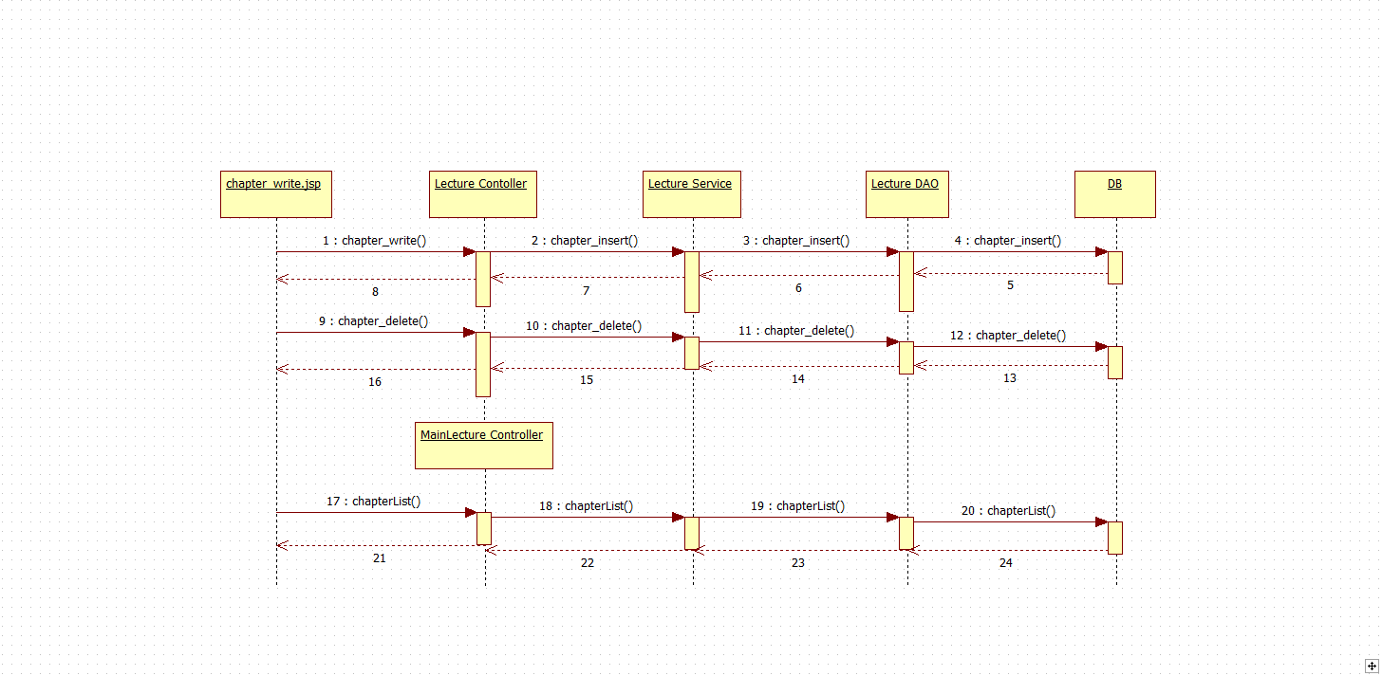
Sequence Diagram

Slide 17
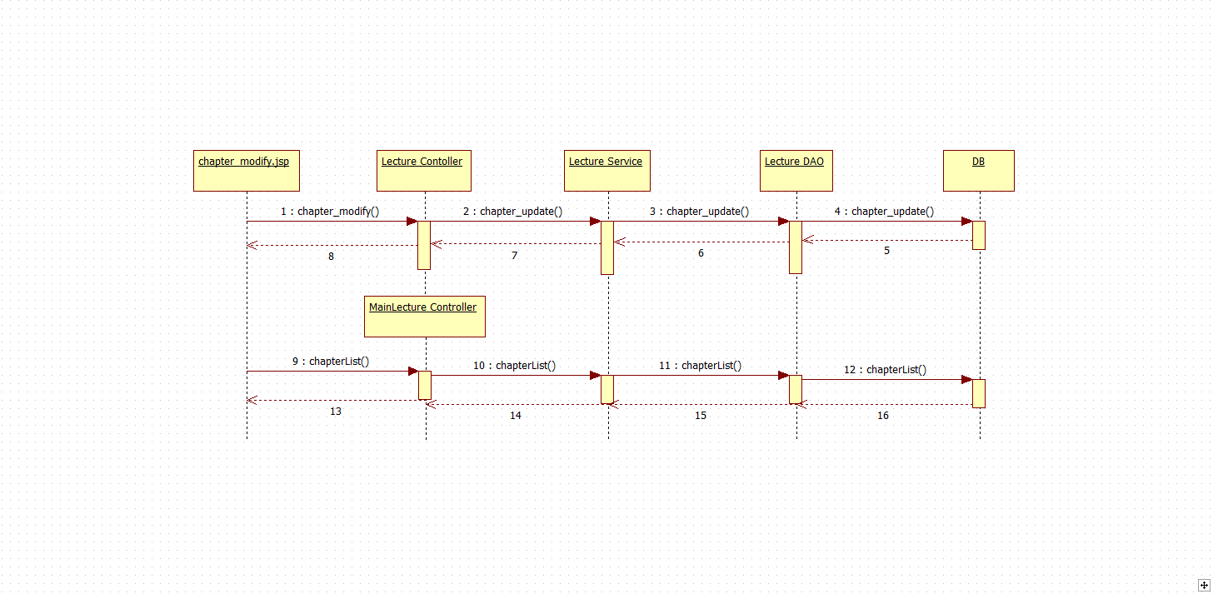
Sequence Diagram

Slide 18
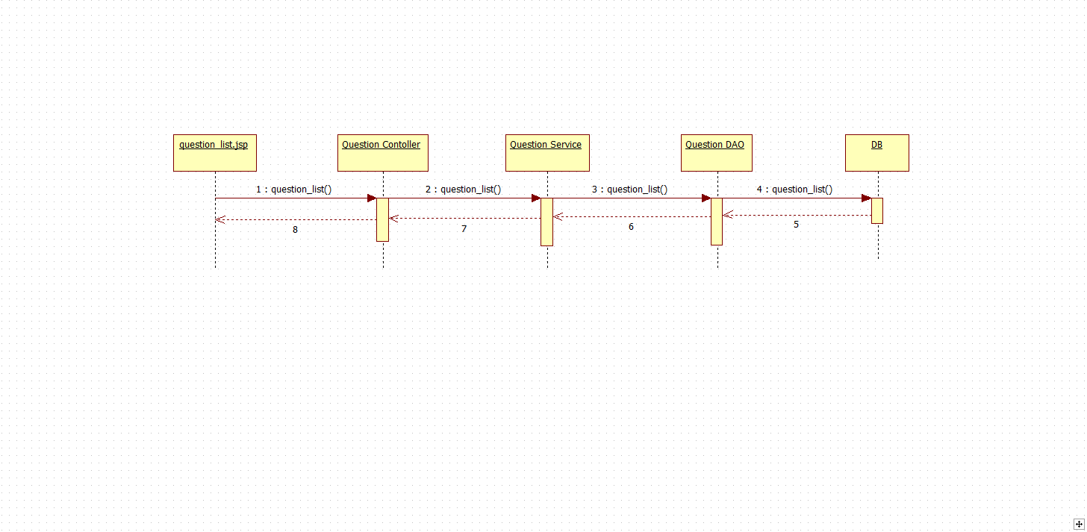
Sequence Diagram

Slide 19
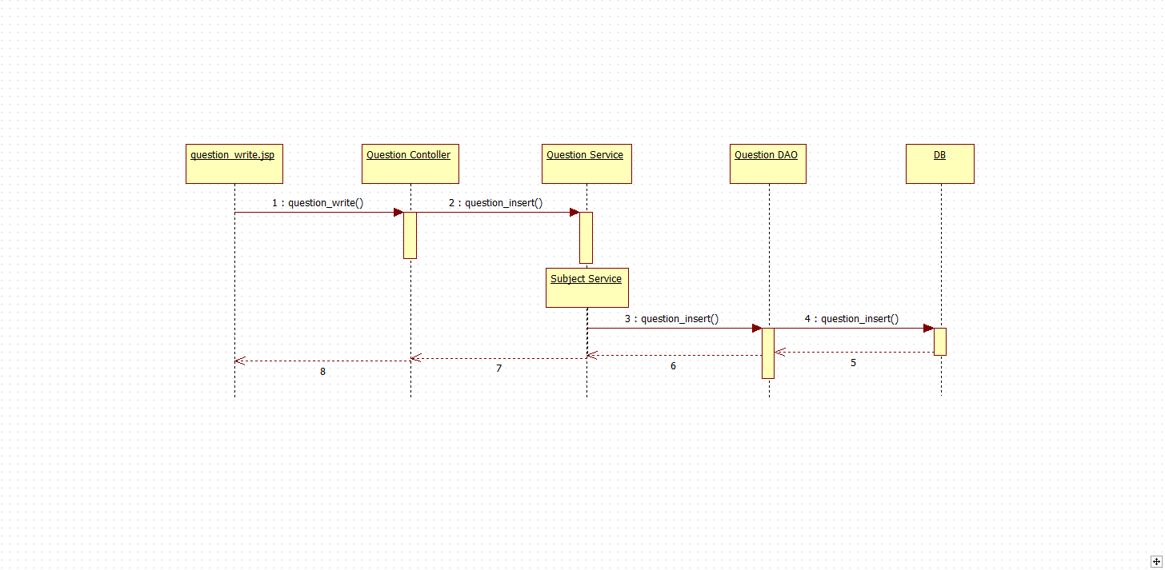
Sequence Diagram

Slide 20
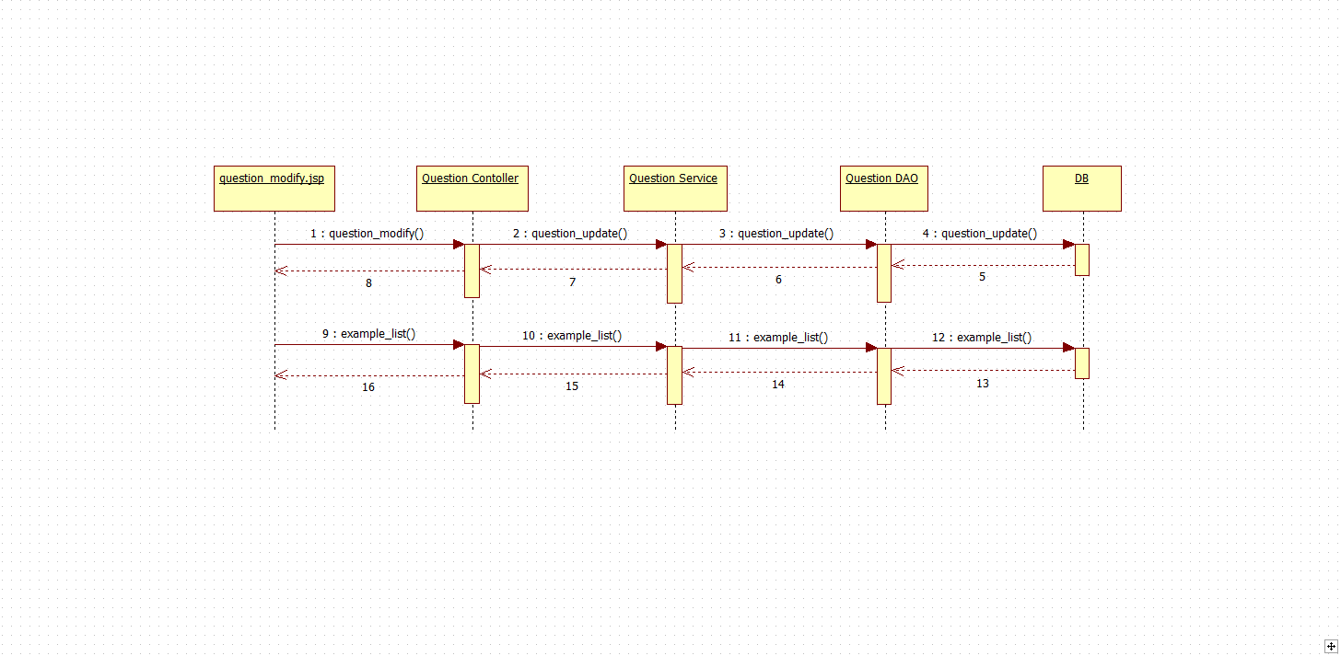
Sequence Diagram

Slide 21
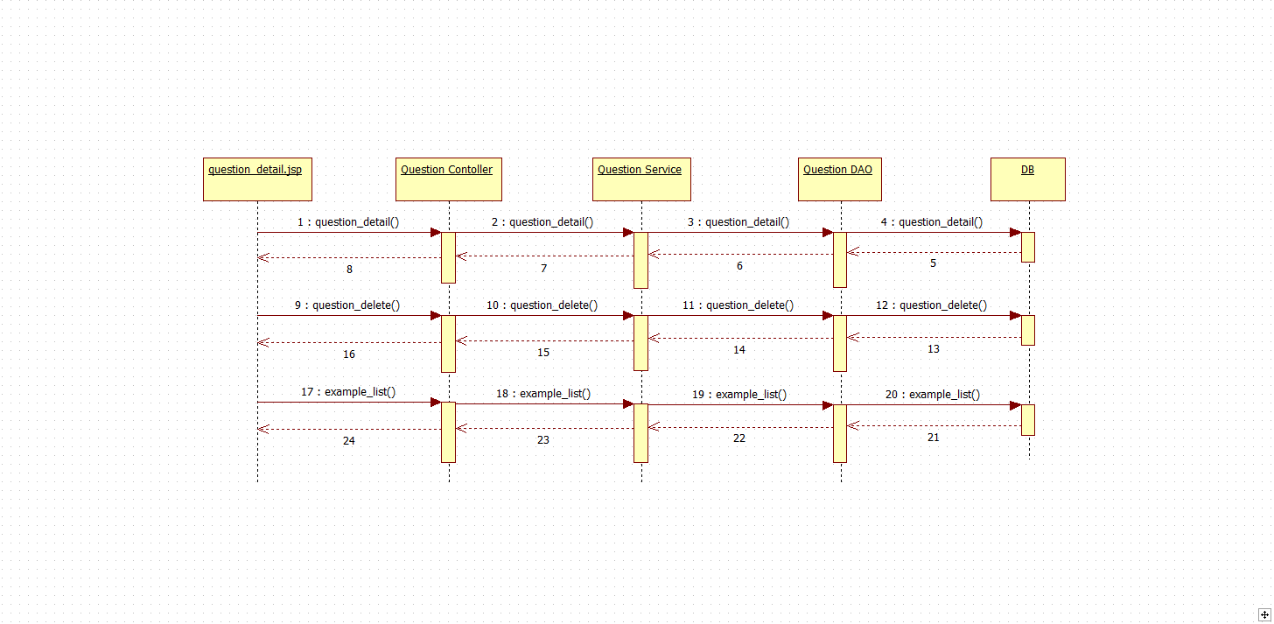
Sequence Diagram

Slide 22
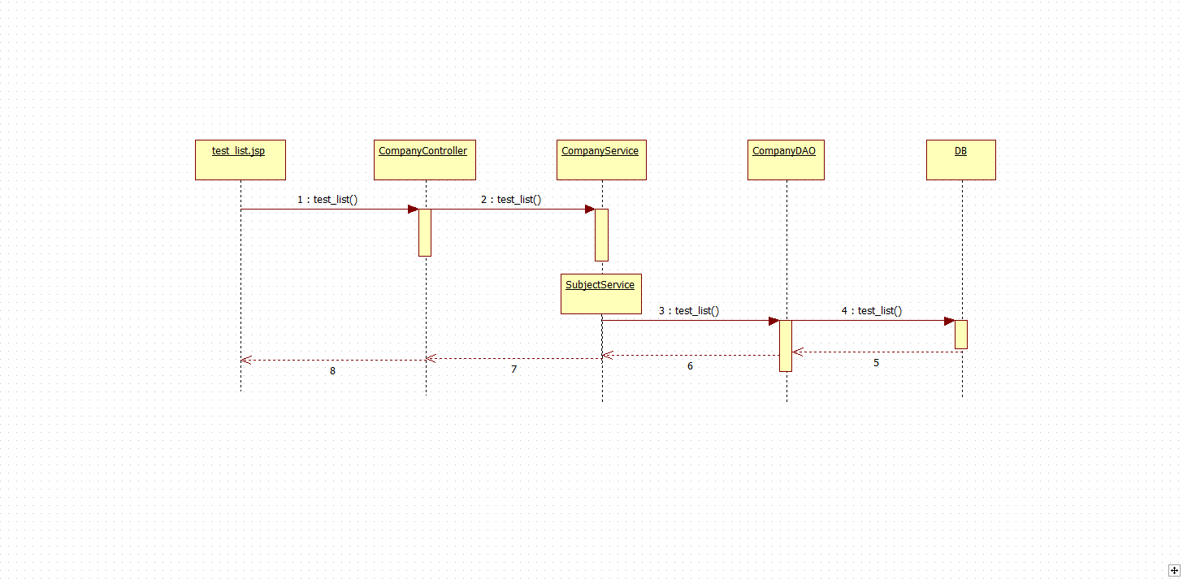
Sequence Diagram

Slide 23
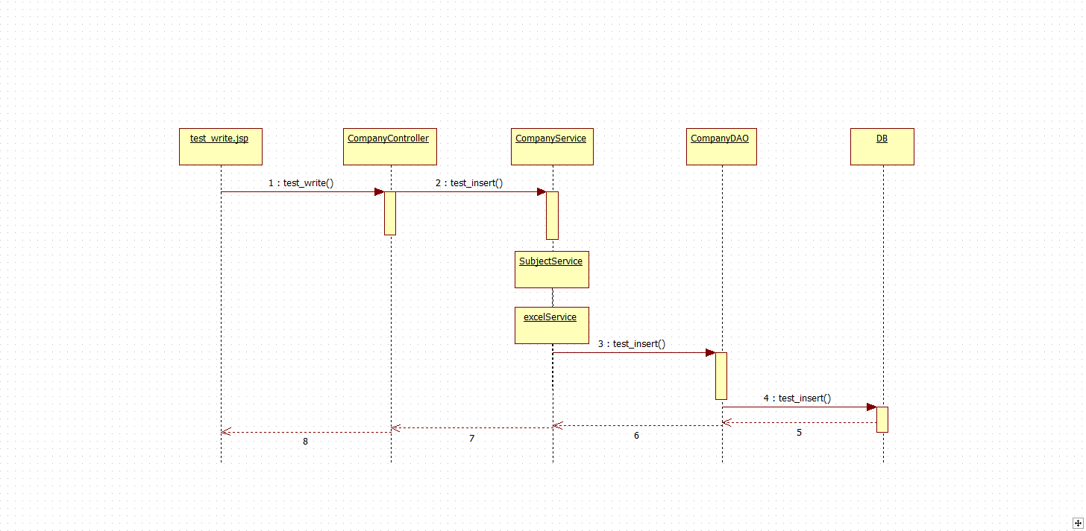
Sequence Diagram

Slide 24
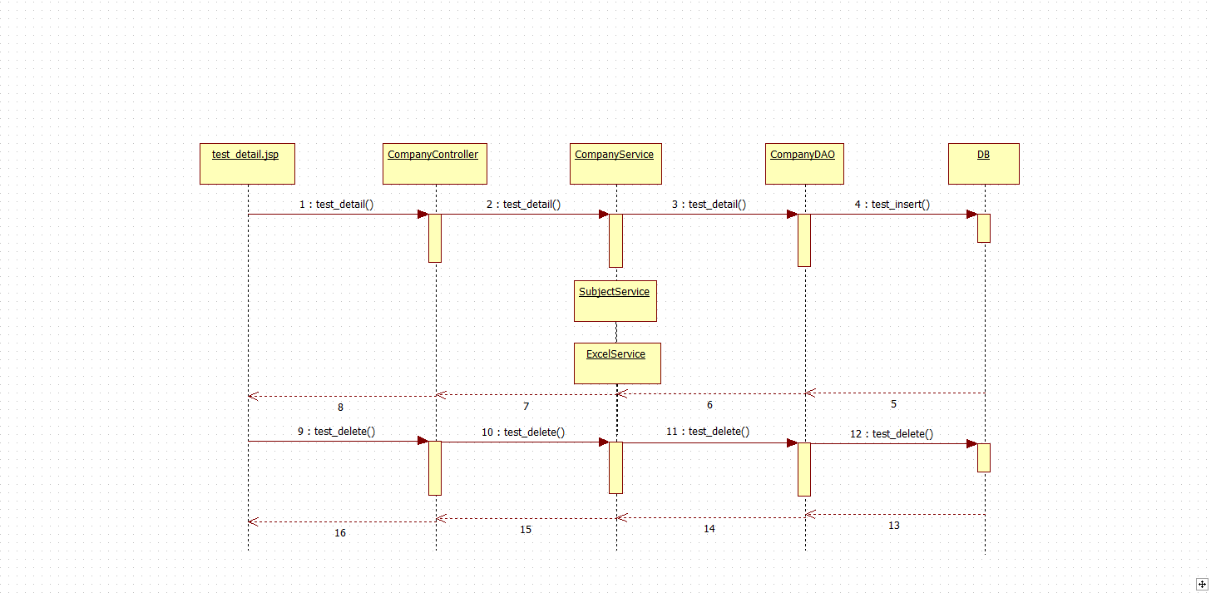
Sequence Diagram

Slide 25
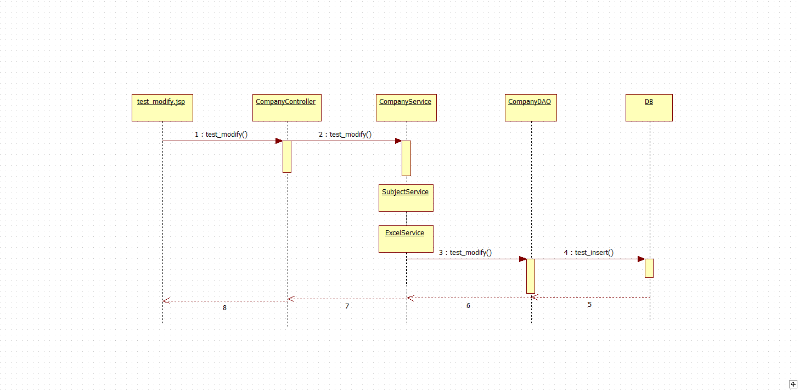
Sequence Diagram

Slide 26
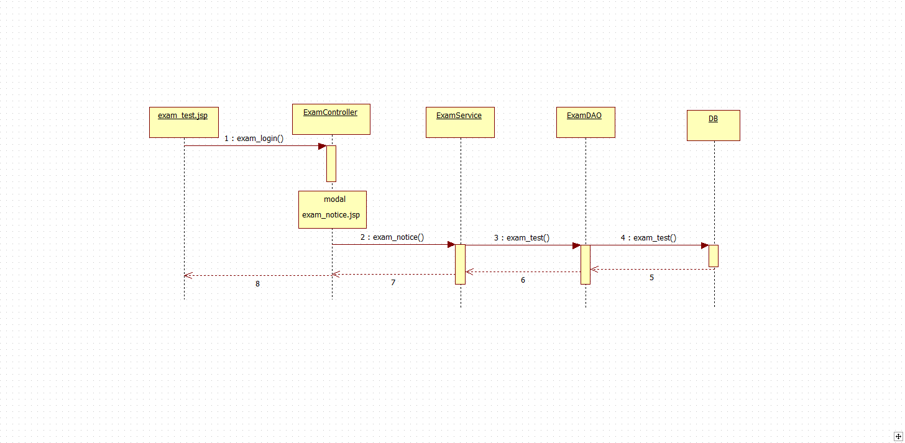
Sequence Diagram

